Slide 1
Static Routing
VLAN, Inter-VLAN, VTP
DHCP, WLAN
HSRP, STP, RSTP, Ether-channel
LAN Security

Slide 2
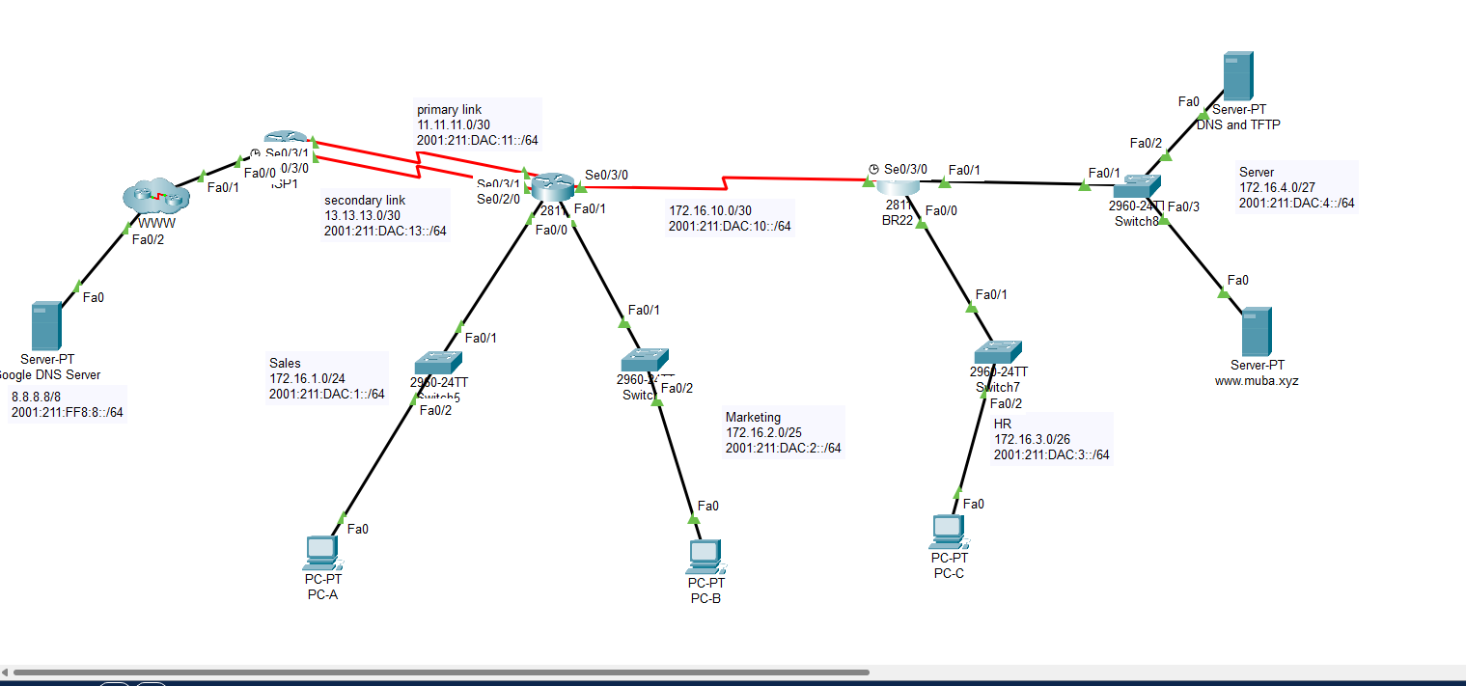
Static Routing

Slide 3
VLAN Steps
Core -> VLAN ID Declaration
Core SW -> VTP Server -> Domain -> Pass
ALSW’s ->VTP Client -> Core SW Domain & psswd
SW – SW: Mode Trunk
SW – End Device > Access/voice (IP)
VLAN Assign to end devices according to ID
Router Port Enable
Router Port Segregation
Encapsulation dot1q VLAN ID
Gateway add
Switch to Router -> Trunk
Declare Native VLAN in all trunk ports amongst switches
Setup Telnet for Management VLAN in switches

